Slide 1
Around the GUI World in 8.0 Minutes
October 24, 2018
Elizabeth Ferrill
Notes:
“Just over one year later, in 1842, the 27th U.S. Congress passed the first industrial design law. Similar concerns bring us together here today, nearly 175 years later. The prevalence of industrial designs in everyday life has grown exponentially since 1842, necessitating a continued development and expansion of that original legal framework.” Director Lee, Dec 3, 2015
“This is especially important given the ever-dynamic nature of creative design.”

Slide 2

Availability of Protection for GUIs
Argentina
Brazil
China
European Union
India*
Japan
Korea
Russia
Singapore
United Kingdom
United States
Notes:
The ICC survey shows that among the 24 jurisdictions studied, 20 allow GUIs to be protected as designs: Argentina, Brazil, China, Croatia, England & Wales, the European Union4 (as an entity separate from its member states), France, Germany, Italy, Japan, Korea, Mexico, Romania, Russia, Saudi Arabia, Singapore, South Africa, Sweden, Ukraine and the US. Chile, Ecuador and the UAE do not allow design protection for GUIs, while in India, design protection may conceivably be granted under the Designs Act but clear guidelines are awaited5.
A well-known case of a design application by Amazon — which was refused protection following examination — illustrates the lack of clarity in GUI design protection in India. The reasons indicated in the Controller’s decision included the argument that the GUI was not a design applied on the article in the finished form to be judged solely by the eye (but was instead just a function of a computer screen which shows only when the device is on) and was neither an integral part of the article nor an article of manufacture. See design application no. 240305, “Graphic user interface for providing supplemental information of a digital work to a display screen” (class 14-02) by Amazon Inc
China - But not wallpapers (startup & shutdown screens) graphics, or text elements – No “human interaction.”
Japan - Technically, not permitted for “embedded software”; Computer applications or operating systems (law may change)

Slide 3
UI Design Rights Growing Worldwide
© International Chamber of Commerce (ICC), 2018
Notes:
Fig. 1, Evolution of published GUI design applications (Locarno Classification class 14-04)
in China, EU, France, Germany, Hague System/WIPO, Hong Kong, Korea, Russia, UK, US, Taiwan.

Slide 4
Level of Review for GUIs
Substantive Examination/Prior Art Review
No Substantive Review
Argentina
Brazil
China
England & Wales
European Union
Saudi Arabia
Singapore
South Africa
Ukraine
India
Japan
Korea
Mexico
Russia
United States

Slide 5



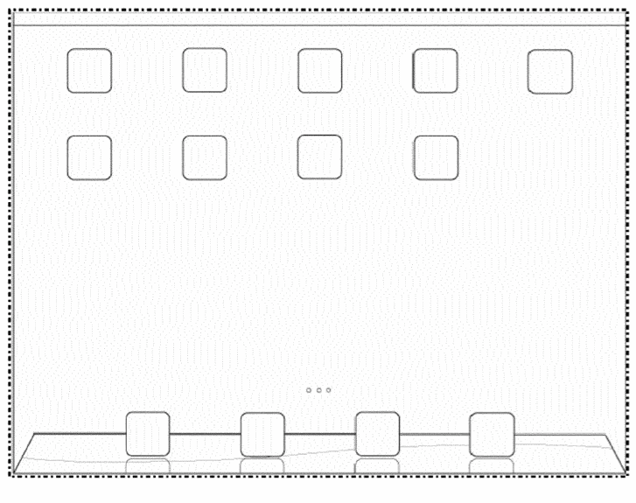
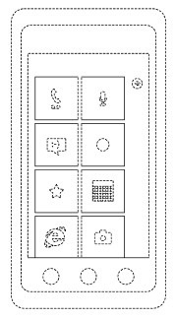
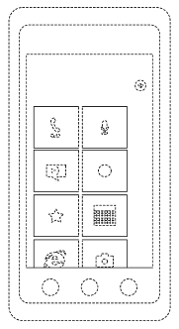
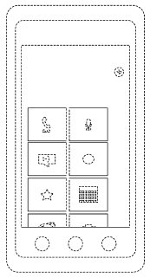
Standard Taxonomy
 | Static | Animated
Icons
Interfaces

Slide 6
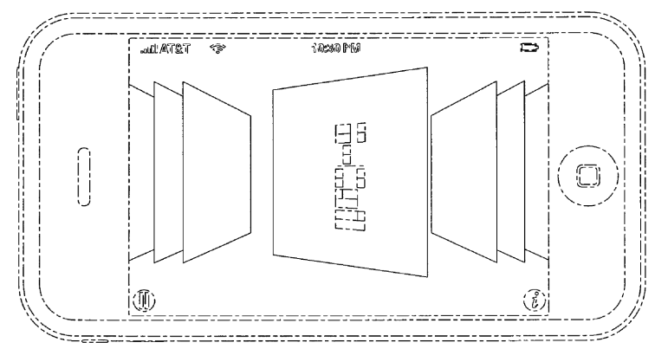
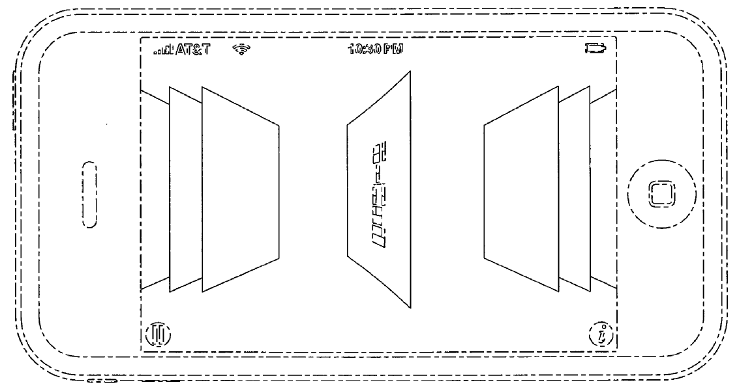
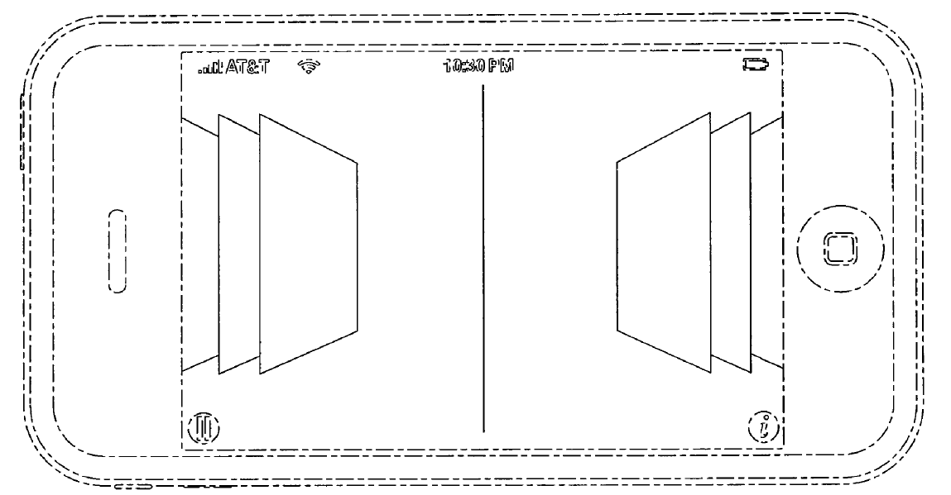
Static v. Dynamic Designs
v.

Slide 7
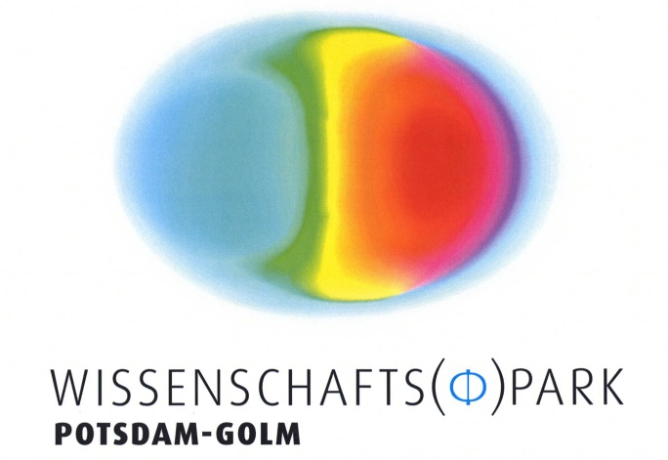
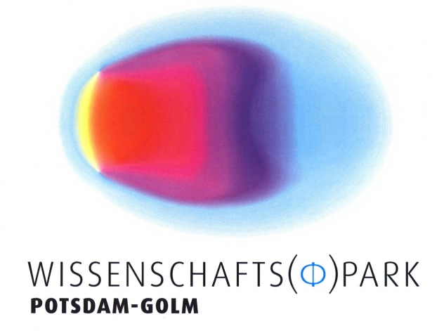
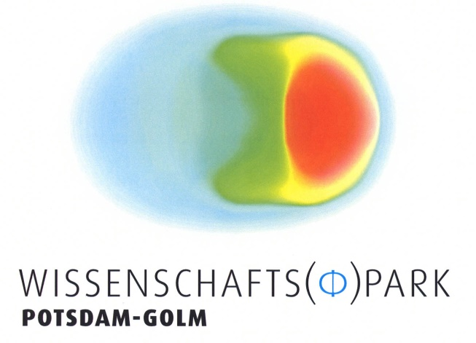

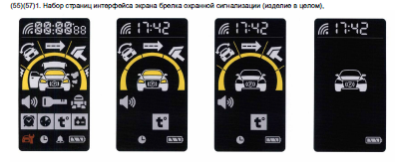

Protection for “Animated” UI
Notes:
EU - GUIs treated like designs for physical articles
Animated designs – treated by physical articles with moving parts
Office of Harmonization for the Internal Market
Publication between 1.5 - 30 months
Multiple designs allowed if in same class
Council Regulation (EC) No. 6/2002 defines “design” and “product” explicitly. Article 3 (a) provides that “design” means the appearance of the whole or a part of a product resulting from the features of, in particular, the lines, contours, colors, shape texture and/or material of the product itself and/or its ornamentation.
Article 3 (b) defines that “product” means any industrial or handicraft item, including inter alia parts intended to be assembled into a complex product, package, get-up, graphical symbols and typographic typefaces, but excluding computer program.
From the definition mentioned above, it can be seen that in design patent protection, EU protects the “design” rather than the “product” itself. Meanwhile, graphical symbols are explicitly included in the protection scope of product, which provides legislation support for GUIs to qualify for design protection.
“individual character”
Russia – must depict all animated UI in a single overview figure
Canada – animated GUIs now explicitly permitted
Australia – animated GUIs not permitted currently by IP Australia, most companies file multiple “screen shots” as individual apps

Slide 8



Physical Display Device Requirements
Device shown,
not specified
GUI registered
independent
Device claimed
Device described
Notes:
Brazil, England & Wales, the European Union, France, Germany, Romania, Russia, Singapore, South Africa, Sweden and Ukraine. – independent of device
Scope of protection also varies –
dotted lines – in Japan v. in U.S.

Slide 9

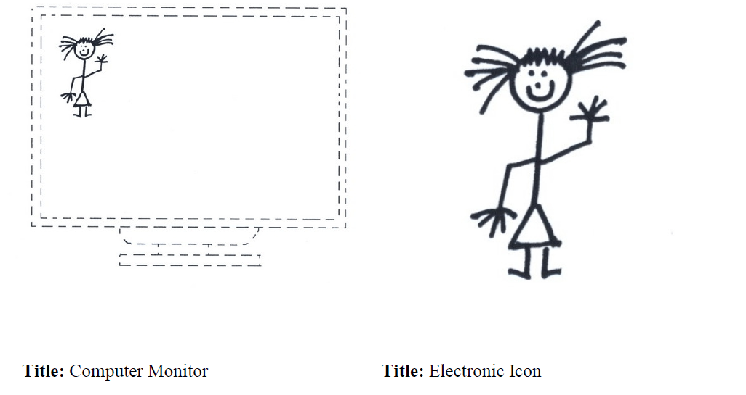
Canada
Acceptable Not Acceptable

Slide 10

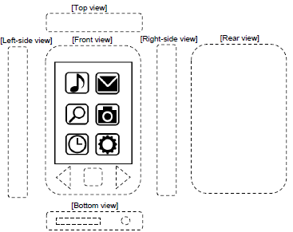
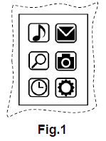
Japan
U.S. Priority Application
Japanese Design Application
Notes:
Priority not denied if you add the device for the JP applications.
Display must be shown, but not claimed
Description of the design and/or its function (Japan)

Slide 11

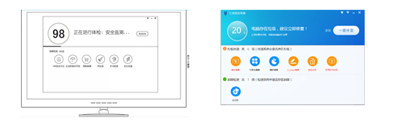
China
Qihu and Qizhi v. Jiangmin
Claimed Design
No. ZL201430329167.3
Accused Product

Slide 12


Augmented Reality & Virtual Reality
Notes:
Open question
Source of difficulties in many jurisdictions – no specific screen

Slide 13
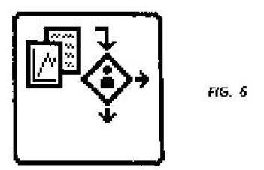
Challenge for VR
Ex Parte Strijland, 26 U.S.P.Q.2d 1259 (USPTO 1992)
  Computer generated icons are “two dimensional” images that are surface ornamentation on the screen
  Need to claim the underlying screen to be patentable subject matter
In re Hruby, 373 F.2d 997, 1001, 153 USPQ 61, 66 (CCPA 1967)
  “We do not see that the dependence of the existence of a design on something outside itself is a reason for holding it is not a design ‘for an article of manufacture.’”

Slide 14
Virtual Reality
US D797,767 Display Screen with a Virtual Three Dimensional Graphical User Interface
Notes:
Issued Sept 19, 2017 to Microsoft

Slide 15
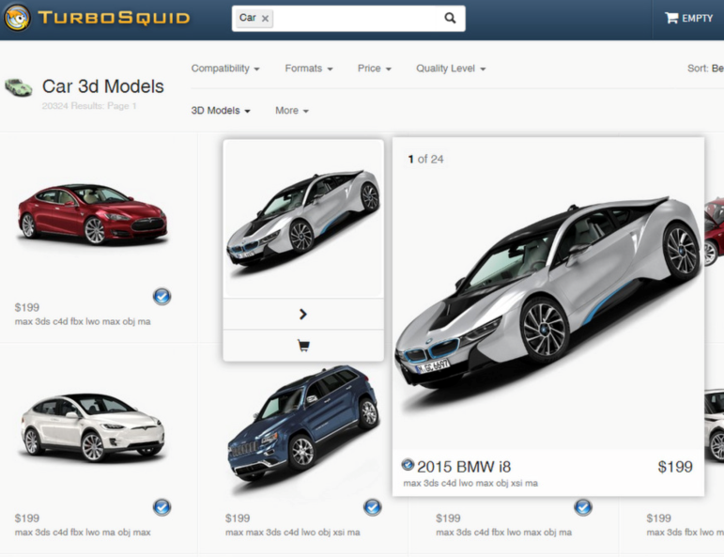

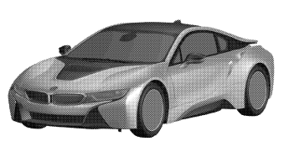
Standard 3D Designs in Virtual World?
BMW v. Turbosquid, Inc., 2:16-cv-02500 D. NJ
6 Design Patents
Turbosquid Website
Settled – all BMW images removed from Turbosquid
Notes:
lots of other claims, litigation might of BMW, tried to stretch – vehicles/replicas, surface configuration, micsllanours computer products…an occurrence that might occur in a video game – how to prepare? appropriate title, reservation of rights.

Slide 16

Highly Interactive Designs
Many different states
Pre-defined?
Sufficiently defined to meet definiteness (112) requirements
Multiple designs/unity of design
Practicality of protection

Slide 17

Conclusion
AR/VR is coming
Design innovators will want protection
Protection of future designs will require creativity and may require changes in local laws
THE ROAD AHEAD

Slide 18

Speaker Information
Beth Ferrill focuses her practice on all aspects of design patents, including prosecution, counseling, and litigation. She also has extensive experience in utility patent litigation in the areas of software- and hardware-related technologies.
Contact Beth:
+1 202 408 4445
elizabeth.ferrill@finnegan.com

Slide 19
Disclaimer
These materials are public information and have been prepared solely for educational and entertainment purposes to contribute to the understanding of U.S. intellectual property law. These materials reflect only the personal views of the authors and are not a source of legal advice. It is understood that each case is fact specific, and that the appropriate solution in any case will vary. Therefore, these materials may or may not be relevant to any particular situation. Thus, the authors and Finnegan, Henderson, Farabow, Garrett & Dunner, LLP cannot be bound either philosophically or as representatives of their various present and future clients to the comments expressed in these materials. The presentation of these materials does not establish any form of attorney-client relationship with the authors or Finnegan, Henderson, Farabow, Garrett & Dunner, LLP. While every attempt was made to ensure that these materials are accurate, errors or omissions may be contained therein, for which any liability is disclaimed.

