Slide 1
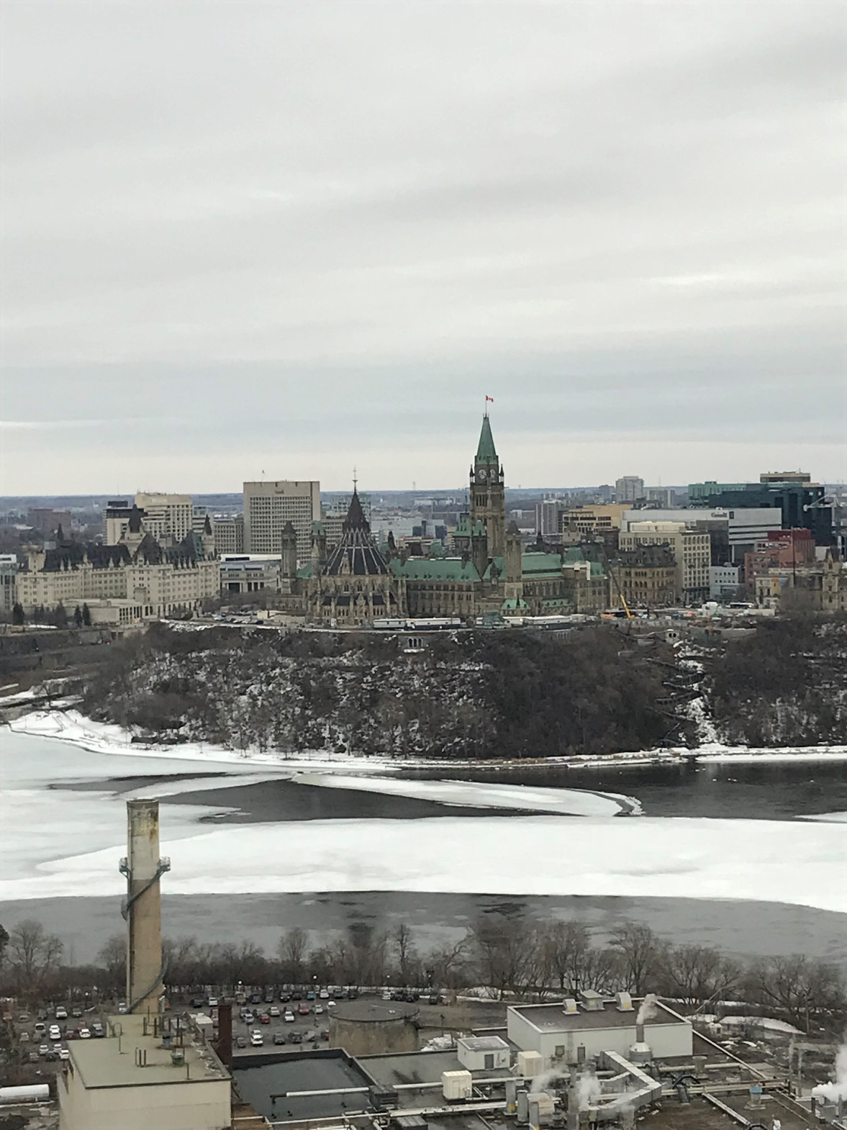
FROM OTTAWA WITH LOVE:
A Canadian Design Update

Slide 2
16 JAN 2017
Computer Generated Animated Designs
Colour as Registrable Design Feature
OA Response Time: 4 to 3 Months
Delay of Registration
Priority Documents
Notice of Possible Refusal
6 New Practice Notices

Slide 5
The design is the visual features of the liquor bottle shown in the photographs, whether they are features of shape, configuration, ornament or pattern, or a combination of such features. The most significant feature is the overall shape of the liquor bottle. Color forms part of the design; the larger main label is predominantly yellow, with traces of green, purple and red, while the smaller lower label and the cap are predominantly purple with yellow portions and traces of green.

Slide 6
5 NOV 2018
1. New Act and Regs
2. New Office Practices
3. Hague

Slide 7
$350 renewal at 5 years
$0 renewal at 10 years
Up to 15 years
10 year term

Slide 8
Designs Available to the Public
in Canada or Elsewhere
>12 months before
the Priority Date
(s. 8.2)
Designs Already Registered in Canada
(s. 6)

Slide 9
Related applications must be filed within 12 months
(s. 31 Regs)

Slide 15
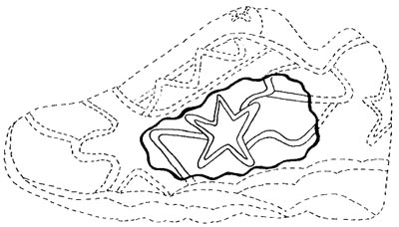

Slide 16
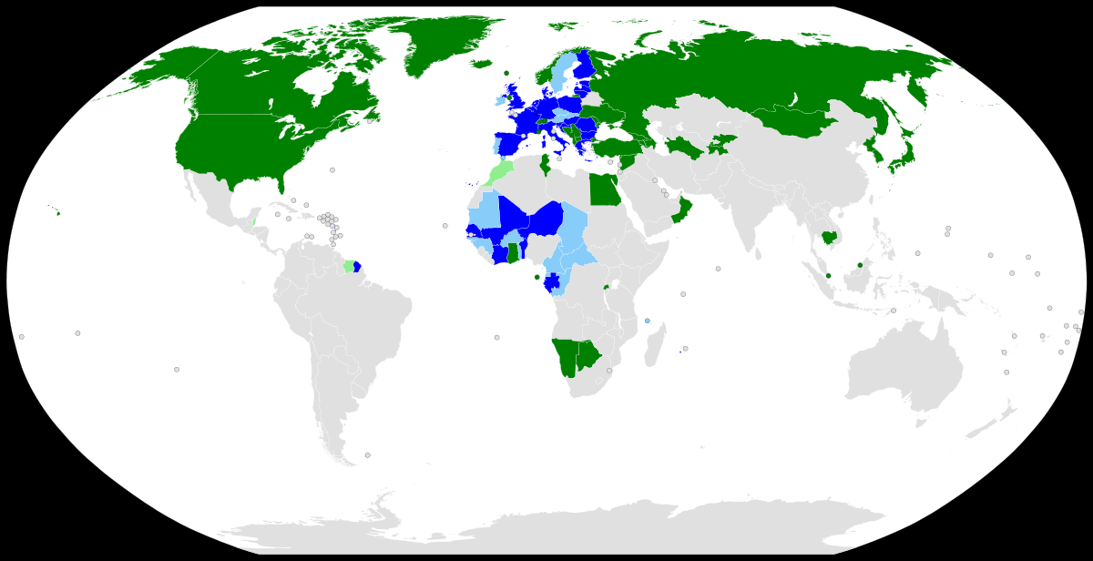

Slide 17
Hague thoughts
Detailed legend & description
Explain disclaimers
Explain colour
Refusal response timelines
Remember the $0 renewal

Slide 18
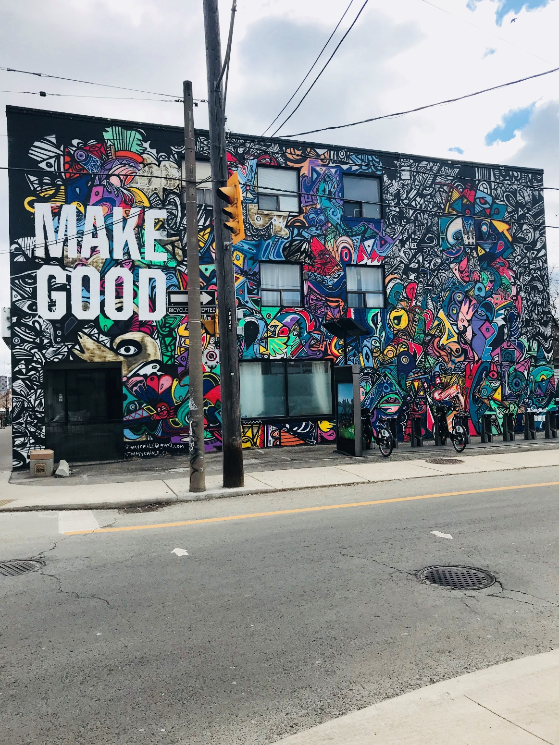

Slide 19
